Slide 1
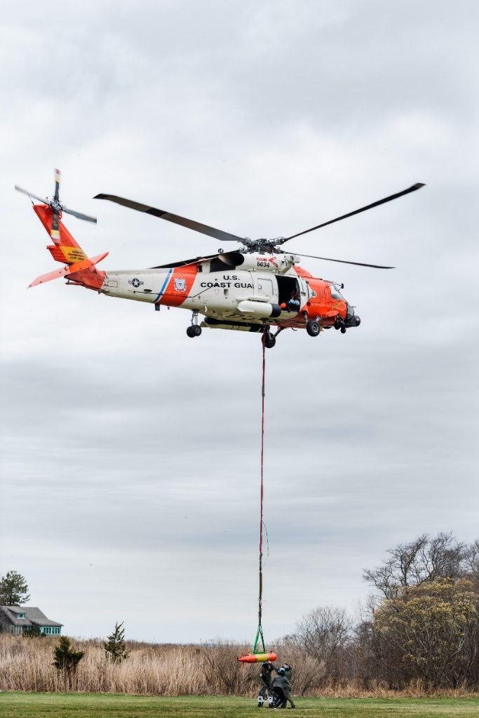
ADAC Year 8 Quarterly Review
September 23,2021
ADAC Project Briefing
(LRAUV) for Under-Ice Mapping of Oil Spills and Environmental Hazards
PI Amy Kukulya (WHOI)
PI Brett Hobson (MBARI)

Slide 2
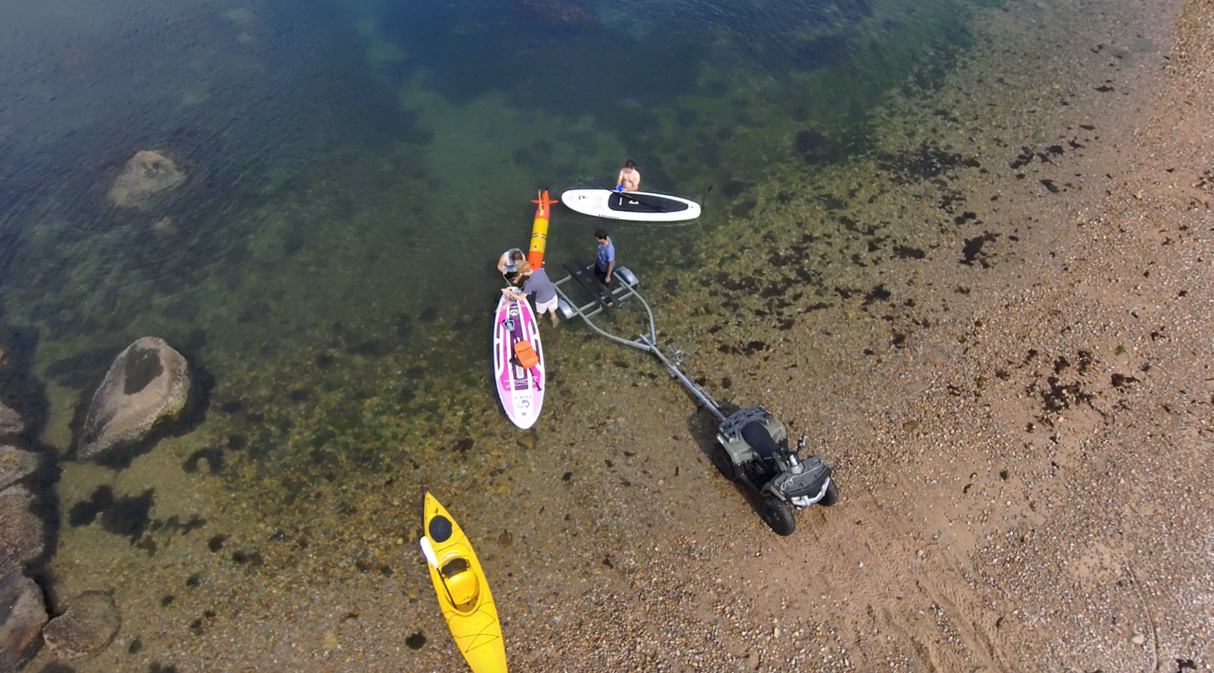
ADAC Project (LRAUV) for Under-Ice Mapping of Oil Spills and Environmental Hazards
Project Principal Investigator(s): PI/PM Amy Kukulya (WHOI), Co-PI Brett Hobson (MBARI)
Woods Hole Oceanographic Institution, Monterey Bay Aquarium Research Institute
Supporting Team: Daniel Gomez-Ibanez, Noa Yoder, Amanda Besaw, Brian Kieft, Ben Raanan, Ryan Govostes, Steven Seeberger, Kaitlyn Tradd, Adarsh Salagame
Project Champion: Kirsten Trego, HQ USCG MER
Project Advocates: Dr. Robyn Conmy, EPA USEPA/NRMRL/RTEB, USCG Research and Development Center, Dr. Jay Choy BSEE/Oil Spill Preparedness Division, Dr. Lisa Dipinto, NOAA, Office of Restoration and Response, Mr. Brian Dolph, USCG R&D Center

Slide 3
LRAUV: Description and Baseline
Baseline: Currently, there is no USCG baseline for an AUV to meet the unique demands of Arctic operations that requires a minimal logistical footprint, a small operational team and oil detection and mapping capability.
Project Description: To develop an Arctic-capable long-range Autonomous Underwater Vehicle (AUV) that is helicopter portable, carries an environmental mapping payload, allowing rapid response while providing situational awareness and damage mitigation for first responders/USCG.

Slide 4
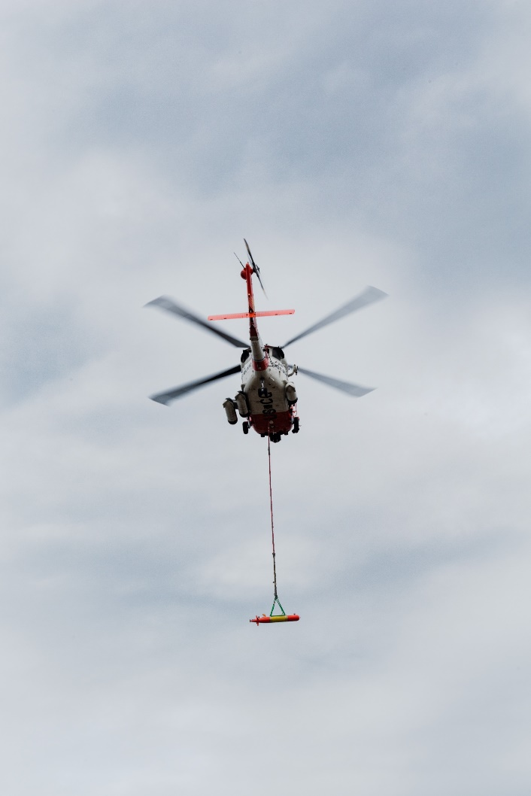
Project LRAUV Relevance and Method
Relevance to DHS and USCG: We characterize the challenge as the ‘last seat in the helicopter’ problem: If first responders are operating at the far end of their logistical support capability, the system must be able to fill that void.
Research Method: Our approach leveraged an existing base Long-Range AUV developed at MBARI (LRAUV), and enhance the system to detect oil and operate under ice. LRAUV offers extended ranges (one to three weeks), and can be operated by a team remotely and monitored by anyone, anywhere.
  Next up:
    Prior (where you have been)
    Current (where you are at)
    Projected (where you are going)

Slide 5
ADAC LRAUV Updates
Backseat- wireless joystick driving (Co-op project)
  Identified limitations in radio signal strength and a radio upgrade is needed in order to achieve longer ranges
Backseat- Sidecar Action Manager development, allowing sensors and behaviors to be developed in a vehicle agnostic way so capabilities can be leveraged across platforms (students, software engineers)
LRAUV backseat computer system health monitor ROS node
LRAUV Software Simulation
  Hardware in the loop to test things like oil spill simulations
  Currently set up with Burger Oil field Simulation

Slide 6
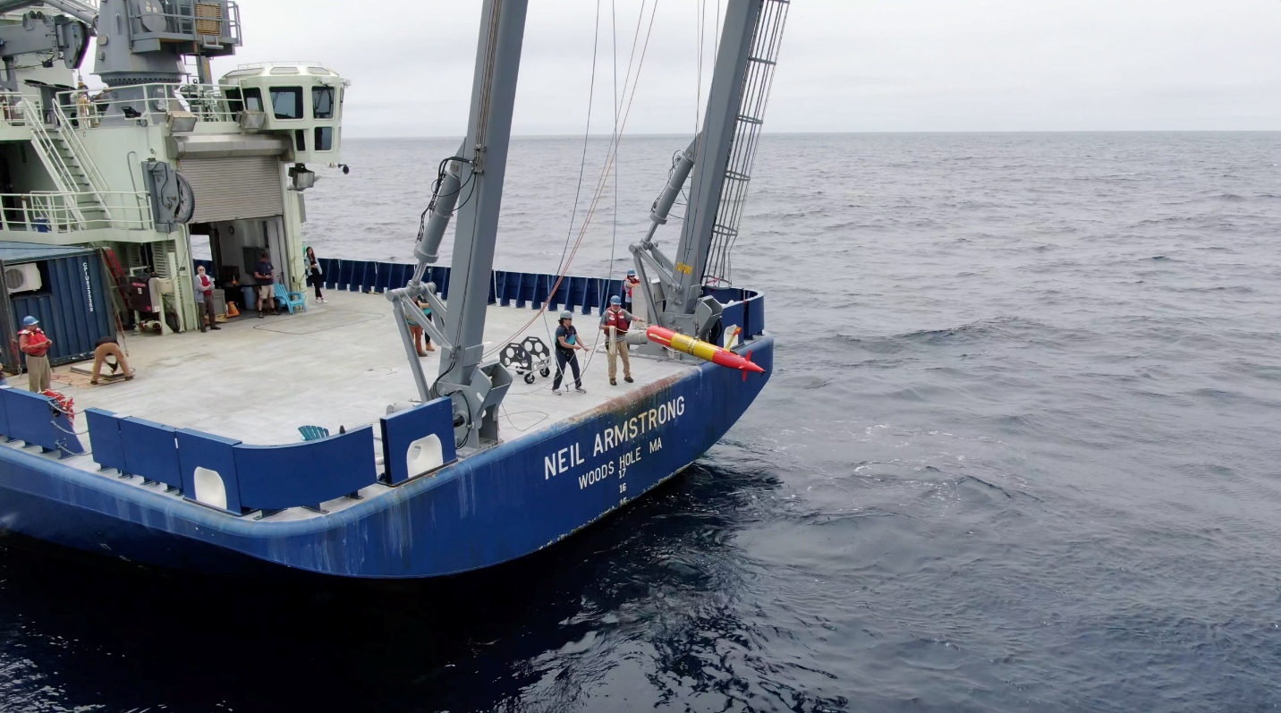
Key Accomplishments
Where we have been:
  Ran 3 over-the –horizon missions.
  Completed 450 km mission offshore (shipless) X 2
  Patent!

Slide 7
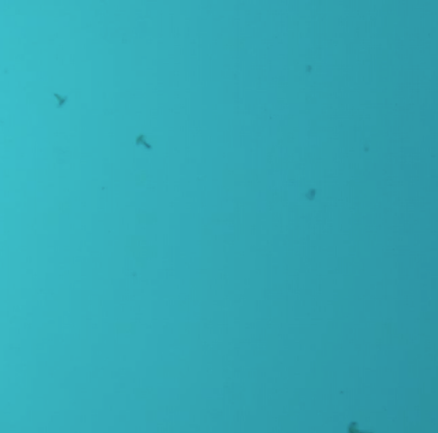
ADAC LRAUV Updates
Leveraged funding from NSF project to develop and test 2D front tracking algorithm
Choose your Proxy
Illustration of the AUV’s horizontal zigzag tracks alternating in westward and eastward sweeps between a western bound and an eastern bound. Over the duration of the sweeps, the front moved southward. On every instance of front detection, the vehicle continues flight for a prescribed distance (marked green), and then turns an oblique angle to fly back to the other water column. When the AUV reaches the western bound, it reverses course.
In one mission on 25 June 2021, LRAUV Polaris detected and passed through the salinity-intrusion front five times. Front detection on each transect is shown in Fig. 8, with corresponding transect numbers.
Snapshot from LRAUV camera capturing squid in a salt intrusion
(Figures courtesy of Yanwu Zhang, MBARI and not for distribution)

Slide 8
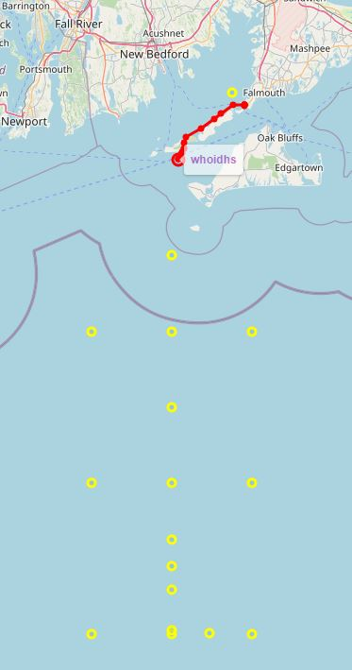
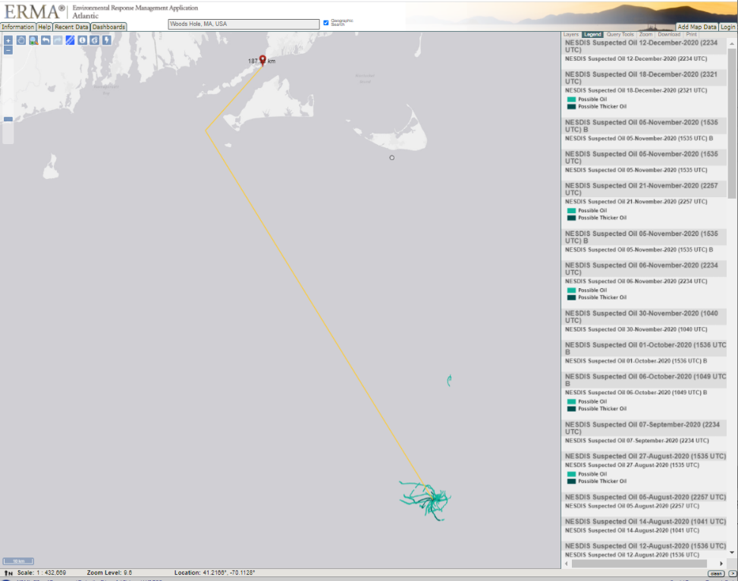
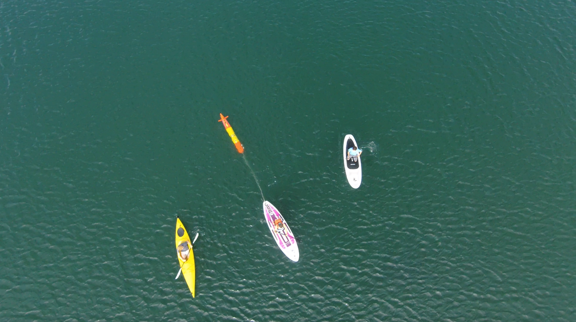
Overview of over-the-horizon mission – Shipless Operations
188 km from Woods Hole shipwreck actively leaking oil….in LRAUV wheelhouse (Scott Lungren (NOAA)

Slide 9
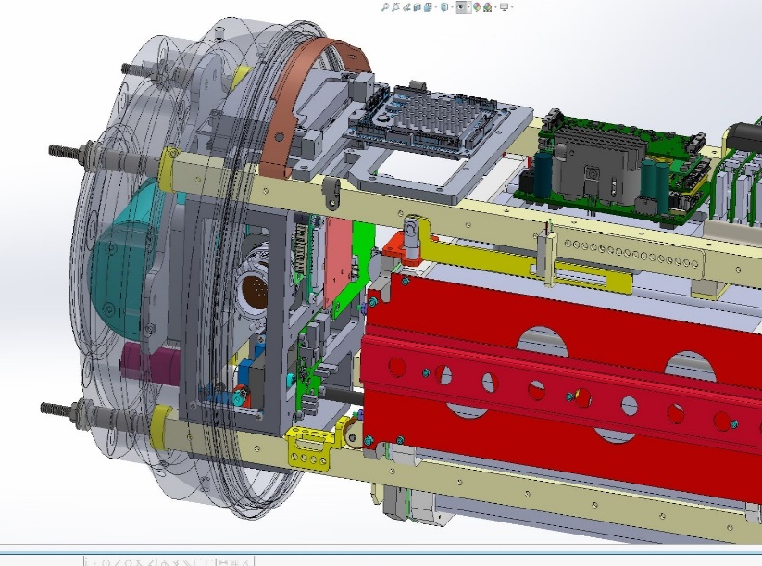
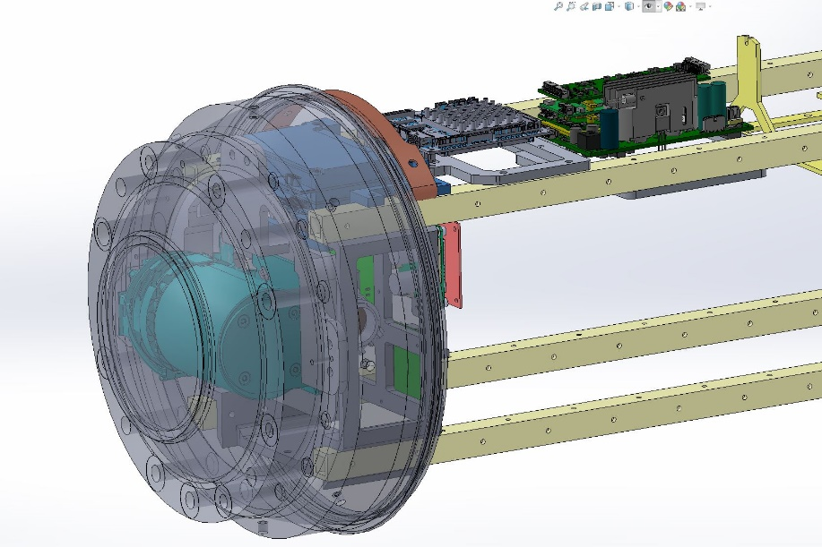
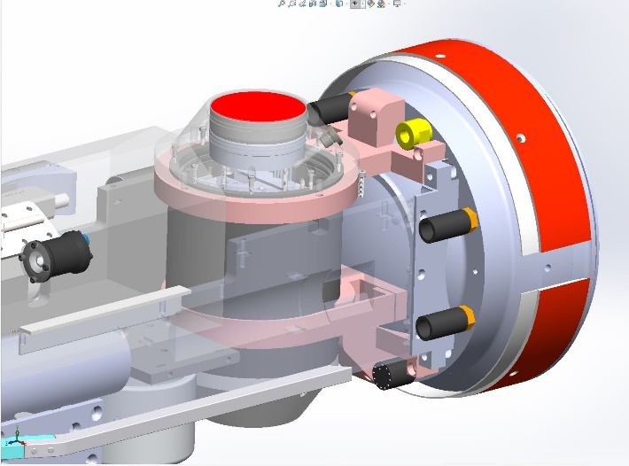
Where we are at:
  Developing LBL (filter updates being implemented)
  Integrating multibeam (NDA just signed 9/27)
  Building Stella and systems (Pressure testing hull and endcaps)
  Refining docking (extreme cold tolerant gearbox installed)
  Developing onboard sim mission for plume tracking tests
  Updating plume tracking algorithm (MBARI testing and then us)
    Burger Oil field Sim
  Building second docking nose (for Stella)
  Working on software for GPS, time, timing (1 PPS), for IMU and sonar, new PIC board
  All updated wiring for new sensors and config complete
  Built vehicle in a box, Proxima (for rapid testing)

Slide 10
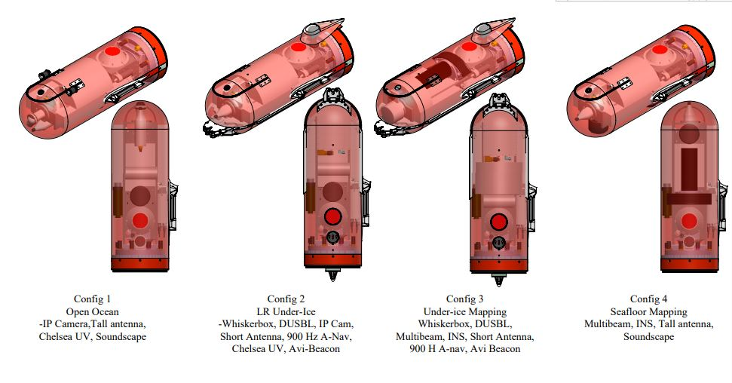
Where we are going:
  Two LRAUV vehicles with four nose configurations:
    Open water science standard sensors, tall antenna, Chelsea UV, Soundscape
    LR under-ice with Whiskerbox, DUSBL, short antenna, Chelsea UV, Avi-beacon with room for camera, 900 Hz A-Nav
    Under-ice mapping, Whiskerbox, DUSBL, Multibeam, INS, short antenna, 900 Hz A-Nav, Avi Beacon
    Seafloor mapping, Multibeam, INS, tall antenna, soundscape

Slide 11
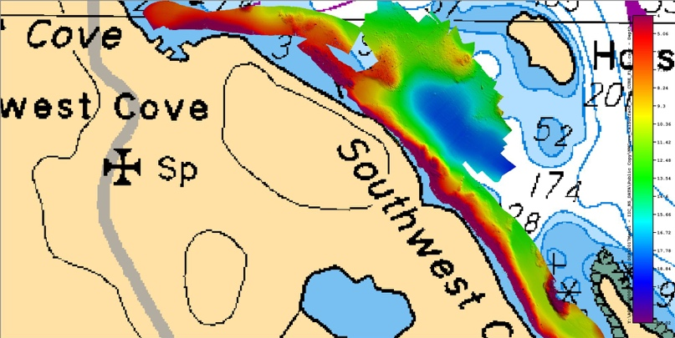
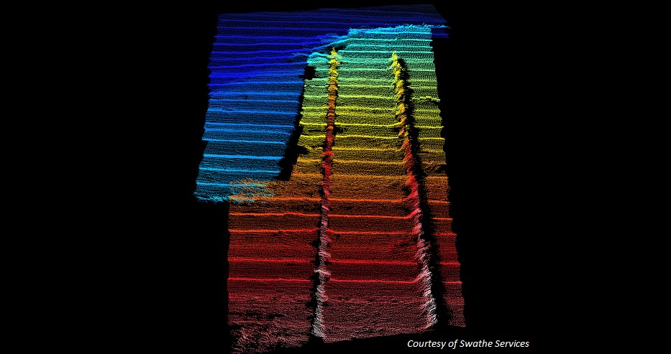
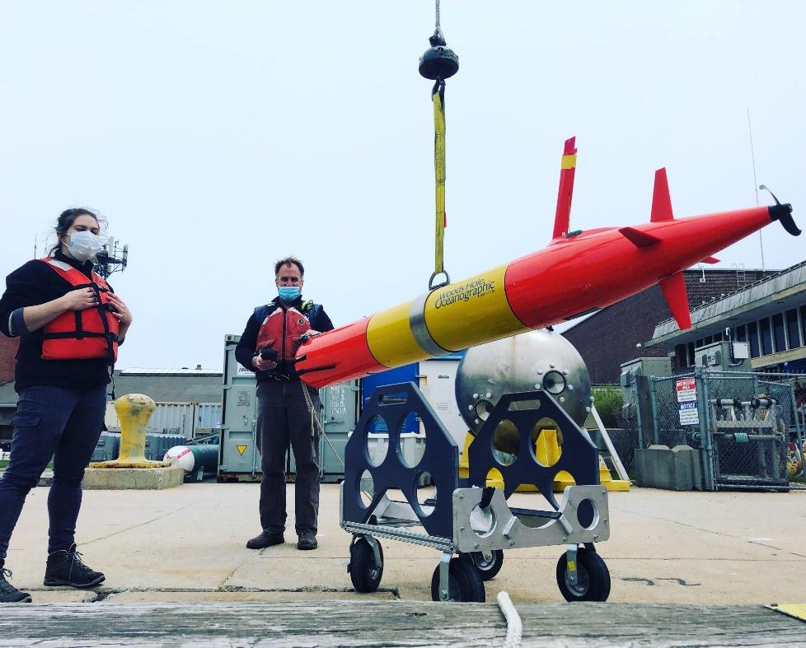
Polaris nose including multibeam
Multi-mission capability
Seafloor mapping
Bathy charts
Shipwreck search/map
Under-ice and glacier mapping
Under-ice and in water oil/gas detection
Notes:
Adding payloads and multi-mission capability
Norbit 400kHz (Frequency Agility 200-700kHz) WBMS Bathymetric System
integrated with Real-time Sonar Head Sound Velocity Sensor. Includes
Snippets, Sidescan, Backscatter and Water Column Output. Includes Sonar
Interface Unit (SIU-I)

Slide 12
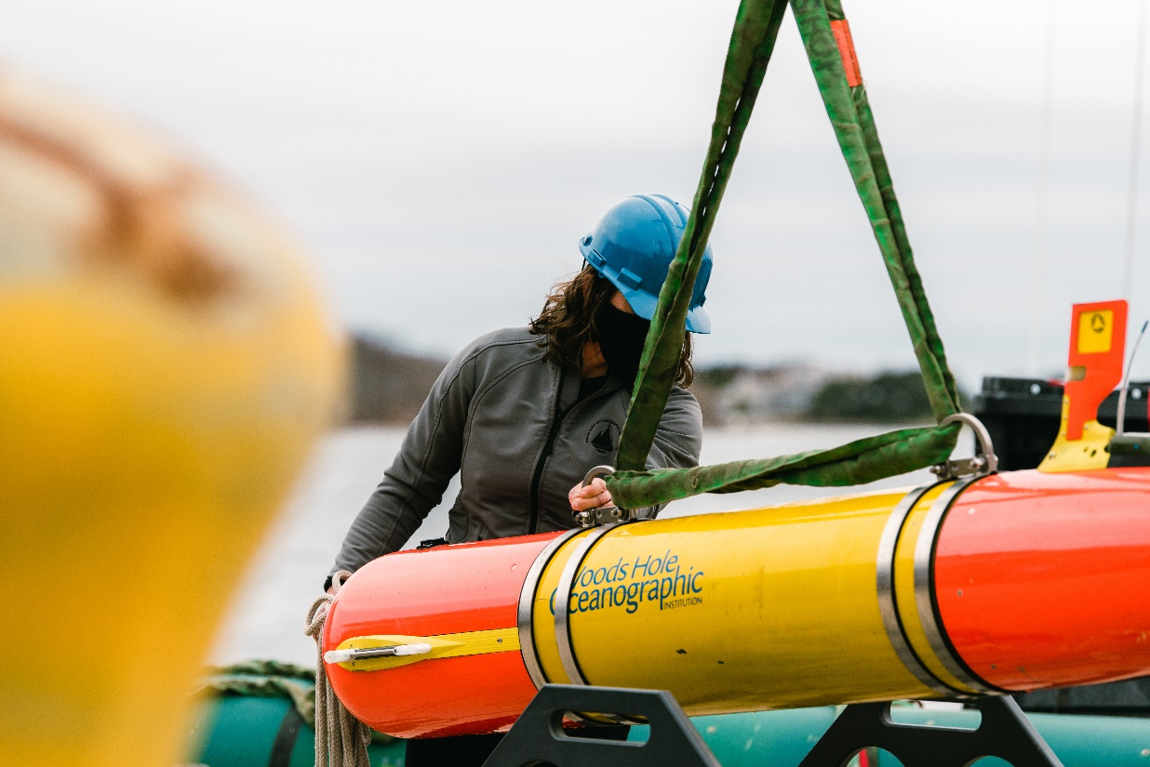
Where we are going: Growing Applications!
  Fly away capability with rapid response for oil spills, sunken ships (etc.), pipe leaks, seafloor mapping, habitat monitoring, measuring soundscapes (weather, whales, etc.), long-range shipless surveys, open ocean, fresh water and under-ice capabilities over-the-horizon data relay, 24/7 operator response
  Center of Expertise
  Go to for help…it’s already happening…USCG, NTSB, NOAA, USGS, Science community…

Slide 13
Project LRAUV: Schedule and Metrics
Fabrication of a second platform (Stella) 12/15
  Main hull/chassis and wired endcaps slated for pressure testing (10/3)
  Transition and training underway
Conduct Arctic Readiness Test, most important and time consuming tasks, majority can be done in Woods Hole (minus high latitude and under-ice)
  Three buoy system completed- one buoy is HF, two LF
  Docking/Undocking reliability ~60% and a new cold weather gear box has being switched out
    New docking code and smaller diameter line being implemented
  Plume tracking algorithm further development in progress (Yanwu @MBARI) is ready to test
  Comms reliability (antenna/buoy/Dash)
Provide testing documentation and familiarization of LRAUV to USCG
  Working on planning a remote training workshop of LRAUV systems capability (Dec ?)
Develop software for improved operator system interface
  Backseat is integrated, new sensors can be integrated.
  Drivers are complete for the multibeam and new NDA allows us to work on data acquisition
  Dash operator Portal is complete at LRAUV.WHOI.EDU and receives monthly updates/improvements

Slide 14
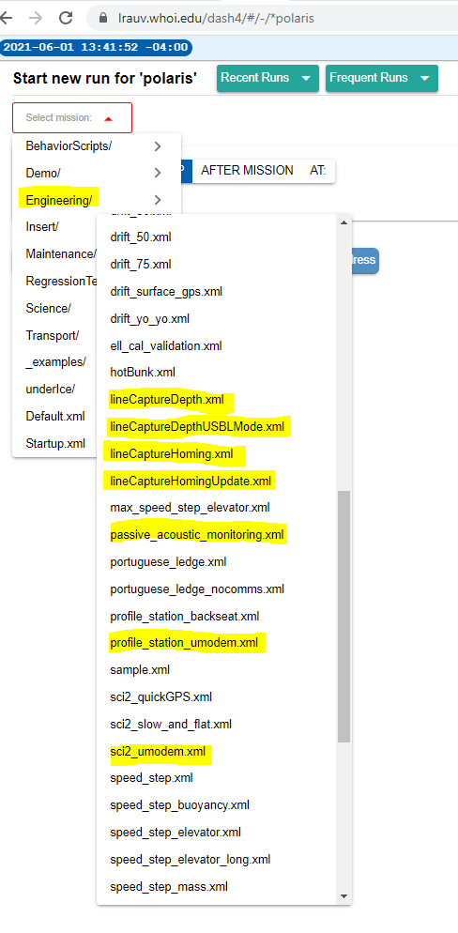
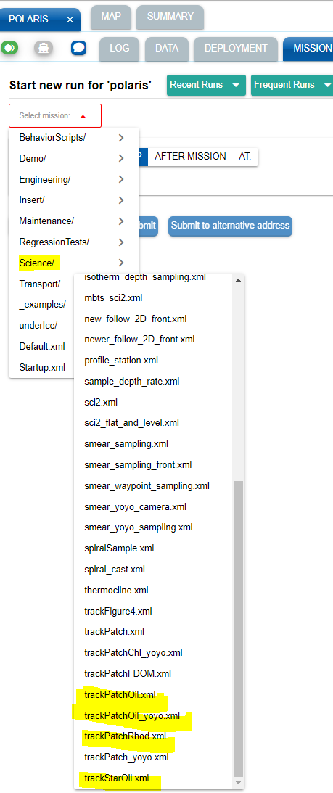
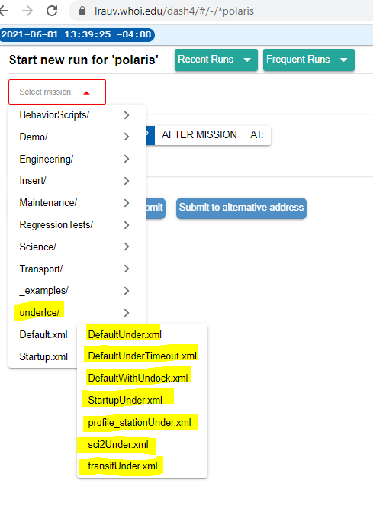
Developed new software behavior missions (>20) for docking, undocking, no surfacing, new sensor configurations, refinement of plume tracking for oil mapping (underway!)

Slide 15
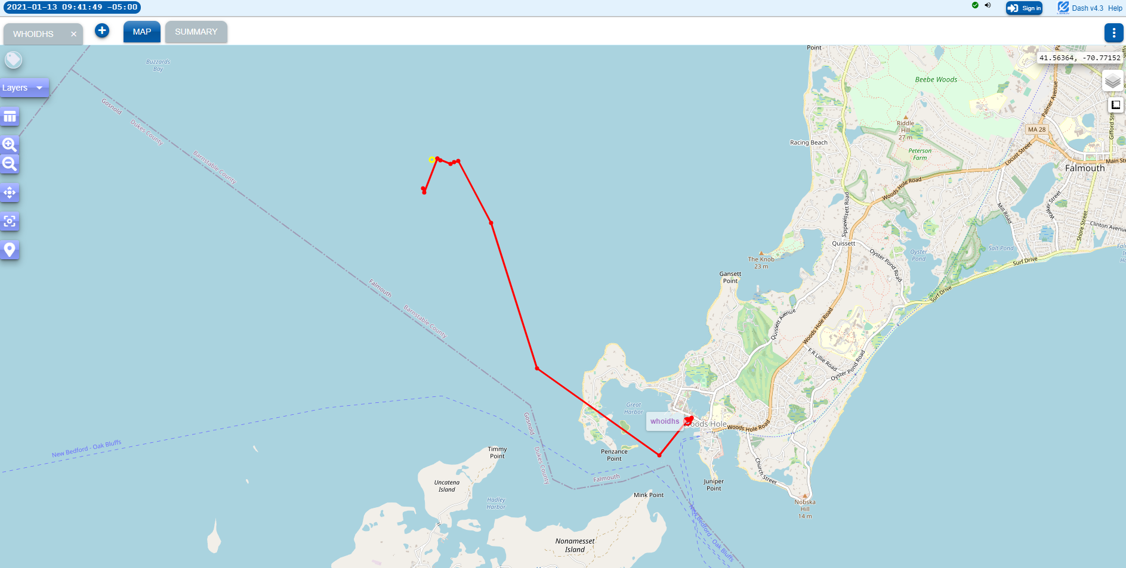
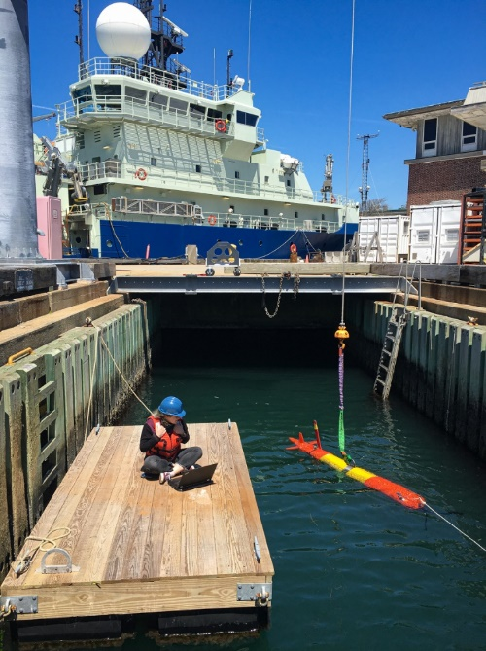
Dash-Command Control:
LRAUV.WHOI.EDU
Next up:
Docking tests (Now-Dec)
LBL tests (15 Oct-Feb)
Finish Stella (15 Nov)
Sonar/INS integration and testing (15 Nov- March)
Complete system vigorous testing and testing of opportunity
Funds to develop transition and training
Funds for prep to July tests- can’t prepare before 31 March

Slide 16
Project LRAUV: Planned Research Outcomes
Planned outcomes of the research:
  A helicopter portable Long Range AUV, for under-ice and over-the-horizon shipless anomaly and oil detection with deployable Arctic buoys for aided navigation, remote communication and docking; around-the-clock expertise available and training with a TRL 6/7 system ready for low-rate manufacturing and payload capability expansion.
Additional research identification:
  Service for hire
  Interest in commercialization
  Interest in scientific community to use and develop tech (BSEE, EPA, NOAA, etc.)
    (more vehicles, deeper ratings, recharge capabilities)

Slide 17
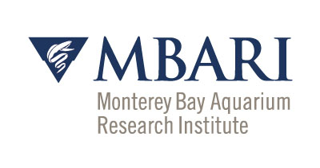

What needs improvement or is missing?
  Sensing of oil against the ice and seafloor and high latitude testing
  More sensor payloads-Echosounders, Cameras, Water sampling, energy harvesting
  More operational time for shake-down and training
  Software development (behaviors) and backseat autonomy
  System upkeep funding
  LARS for helicopter---have ideas
  How can we be ready and respond to current events? Orange County?
Who should we connect with to improve odds of success?
  Engage with USCG operators early and frequently
  Broaden R&D support
  Be a part of oil spill technology and response meetings?
  Need to coordinate field operations with first responders and fill technology gaps that are identified.
  Continue to connect with alternative funding sources like ONR, NOAA and BSEE to help fund operations and sensor development (methane, what else?)
  Need more vehicles
Input on future from you: Do we need 2, 5, 10 vehicles?

Slide 18
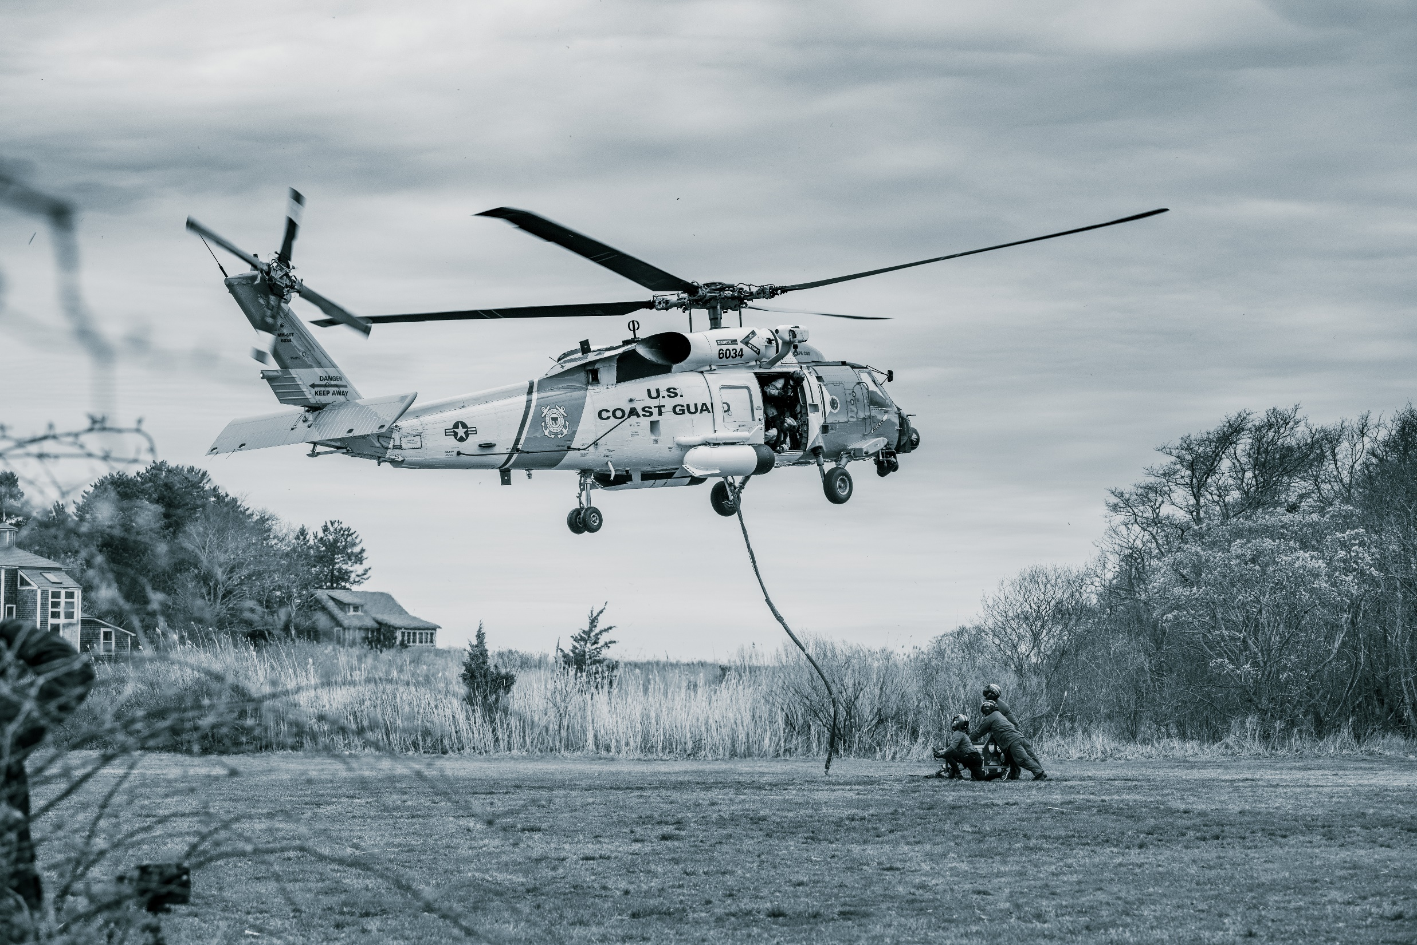
Transition…

Slide 19
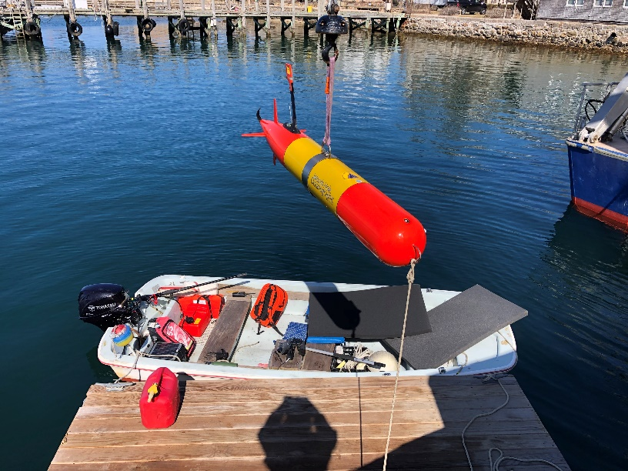
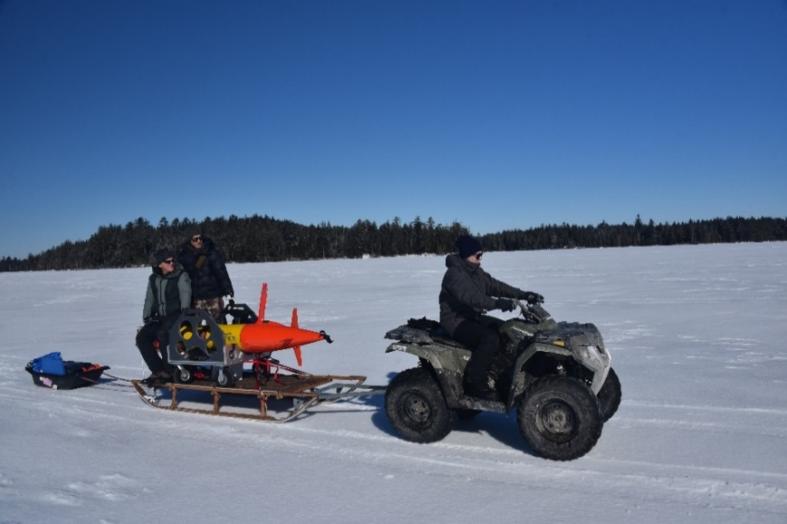
Project LRAUV: Transition Plans
Two-Stage Transition Plan:
  Build one or more systems to support USCG complete with successful open-water and under-ice demonstrations. WHOI trains USCG operators with support funding. WHOI can support USCG on site or remotely via iridium vehicle communications as needed. 24 hr support possible.
  Commercialize resulting platform: Based on lessons learned from (1), prepare the system for commercialization by accessing WHOI CMR fabrication resources. LRAUV was not designed for efficiency of manufacturing and rapid prototyping, therefore revisiting AUV design is a top priority.

Slide 20
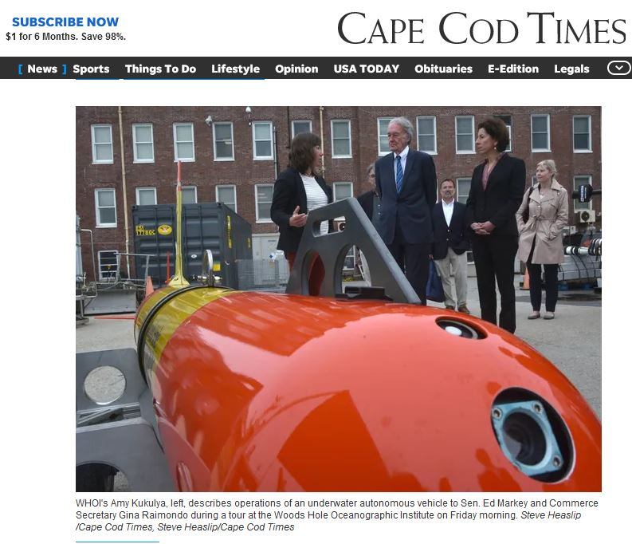
Project LRAUV: Transition Plans
Pathway to Transition:
Create an operational system that the USCG can use for characterizing spills in ice-covered ocean environments. Transition advantages of the LRAUV platform:
  Contains commercially available sensors
  Can be replicated for the USCG
  Has a proven vehicle design and proven reliability
  Sensor commonality

Slide 21
Project LRAUV: Transition Plans
Transition Plan includes the following:
  Facilities: WHOI operates facilities for fabrication, testing, logistics (on-ice support) and platforms such as ALVIN
  Service for-Hire: Operators and AUV’s such as the REMUS are available for hire and also have been transitioned into both the Navy and commercial sectors
  Hardware Builds: WHOI has a history of replicating systems and training end users
  Commercialization: Demand for WHOI built systems may occur through spin-off companies or through licensing the technology to a commercial entity. (example: Hydroid Kongsberg with REMUS and Bluefin from MIT, Bellingham)

Slide 22
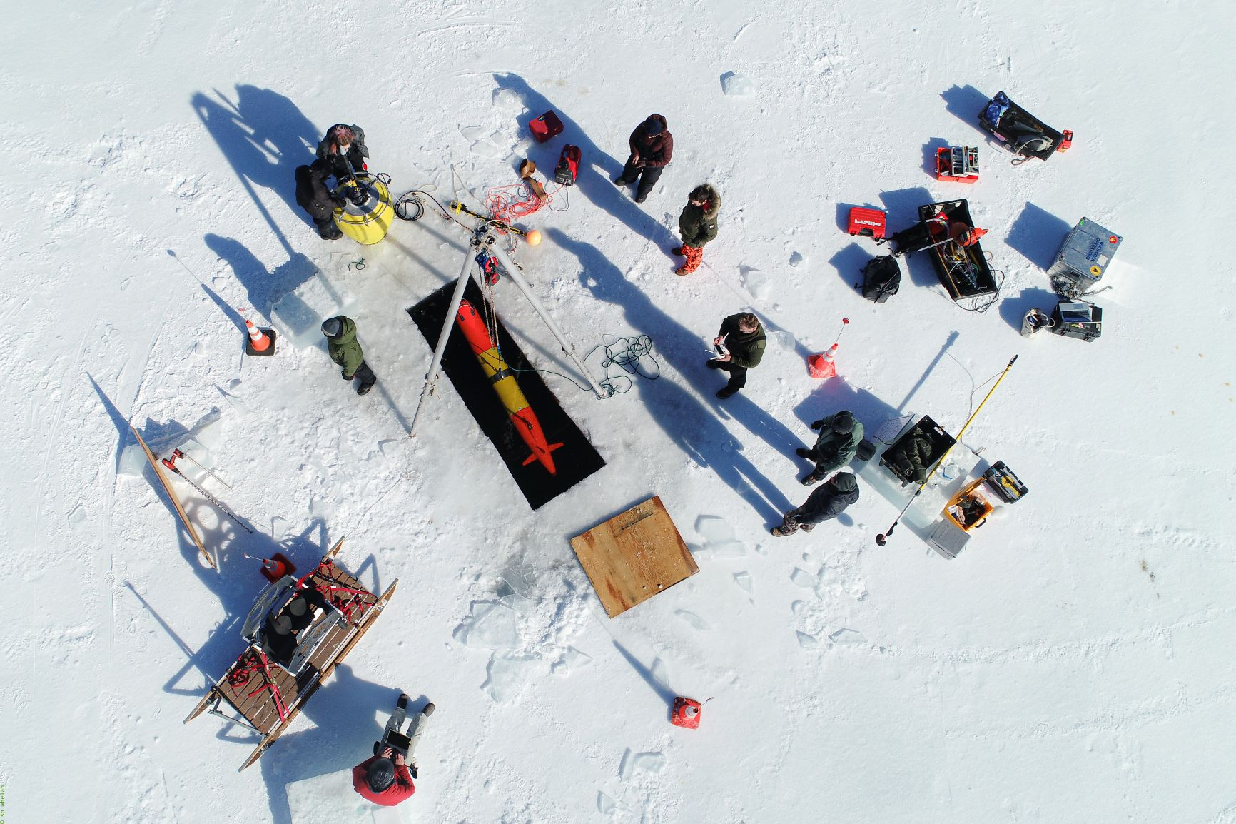
Thanks and
LRAUV Ready for questions

Slide 23
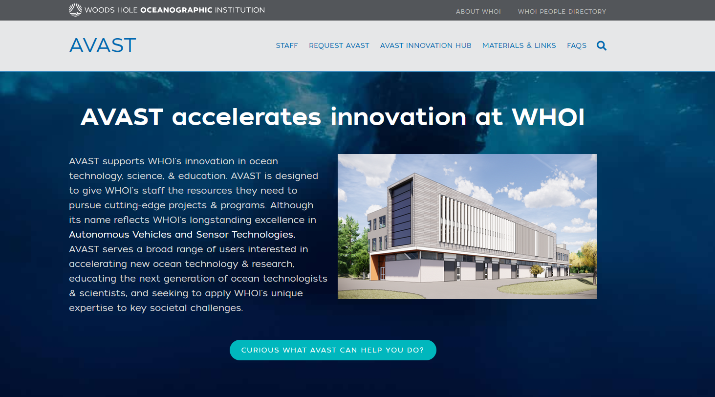
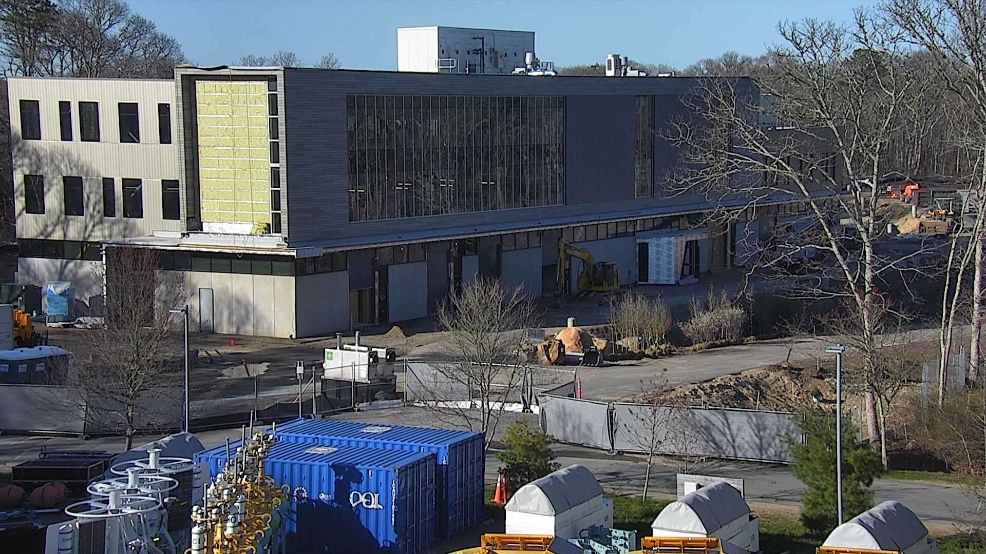
Notes:
Describe how NQF fits in the overall plan, tenants (mooring/rigging, machine shop?, AVAST). Describe the informal advisory groups that operated over the last year, Mark’s establishment of this group.

Slide 24
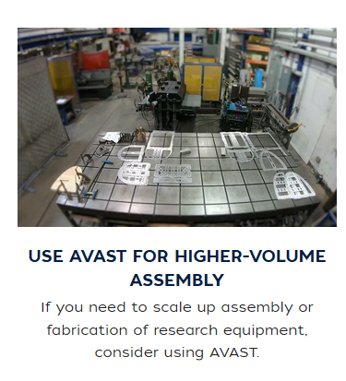
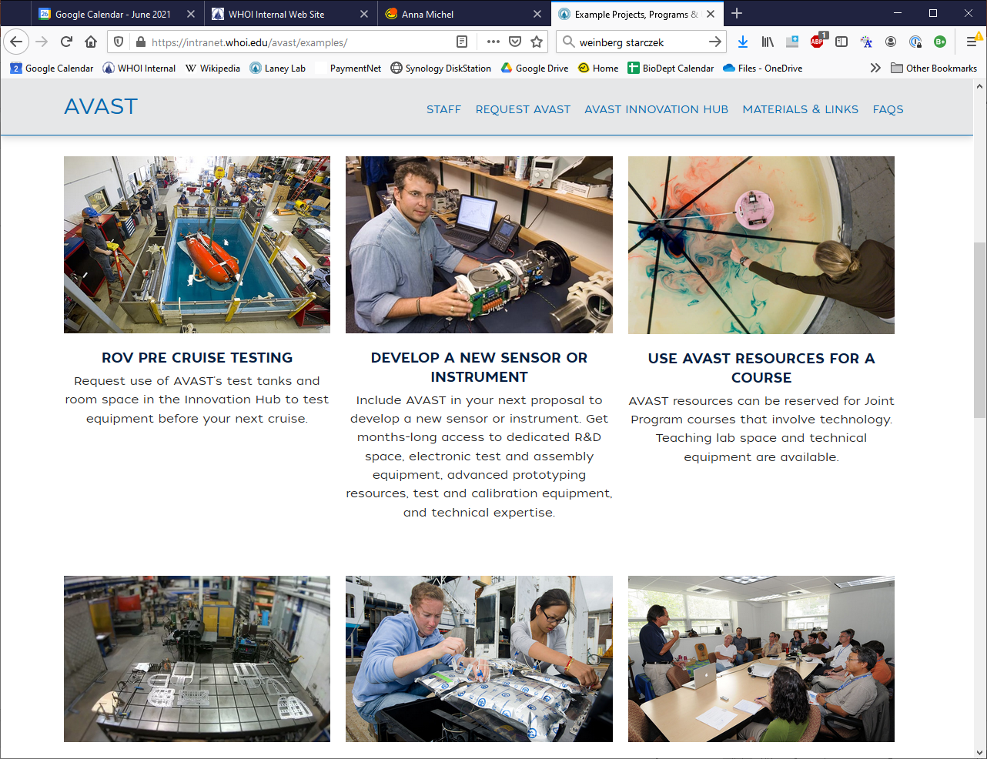
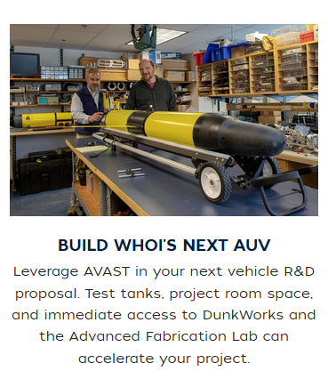
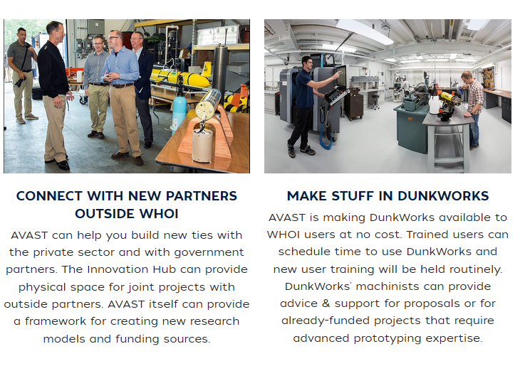
AVAST brings together in one place a wide range of WHOI’s longstanding areas of expertise.

Slide 25
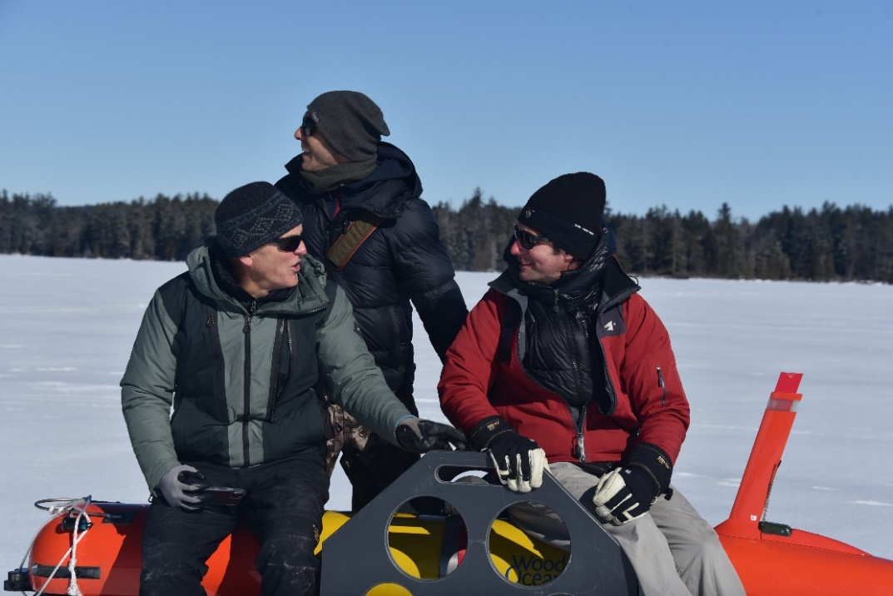
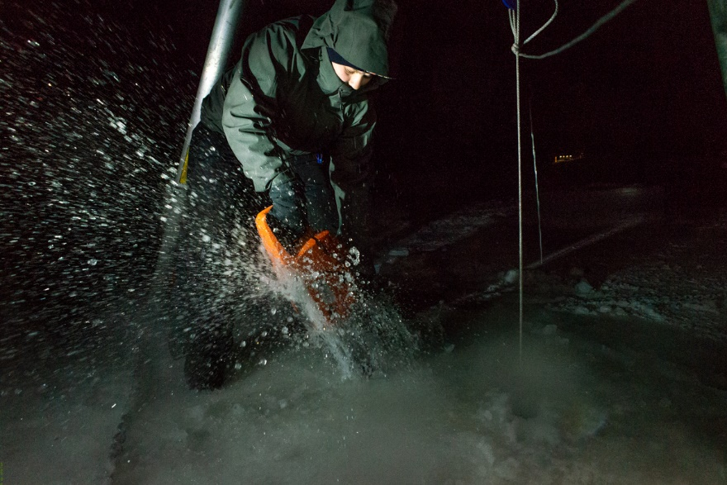
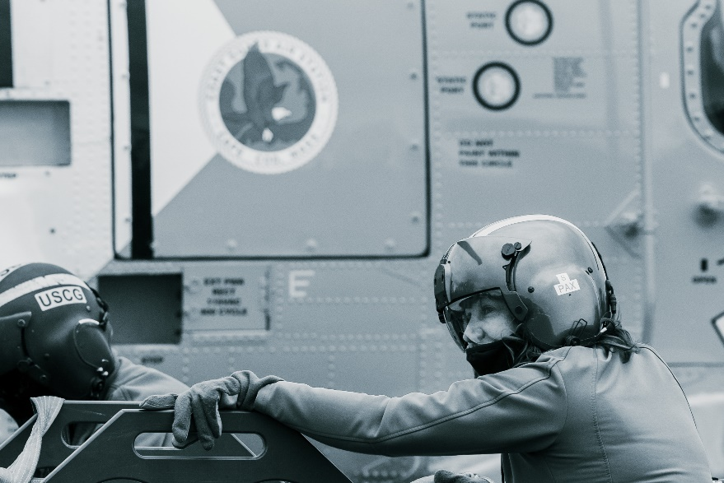
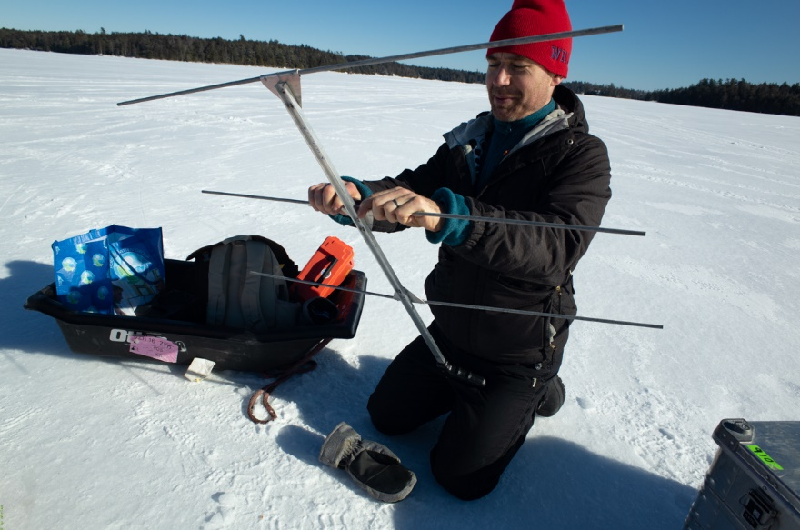
The WHOI-MBARI Operations/Engineering Team
Noa Yoder, WHOI
Daniel Gomez-Ibanez
MBARI’s Brett Hobson, Ben Raanan, Brian Kieft
Amy Kukulya
Not pictured: Amanda Besaw, Ryan Govostes, Steven Seeberger

Slide 26
Project LRAUV
  MATTS and STATS for YR7
Talk- (NASA) Destination Space 2021, April 29, 2021, Kukulya
Virtual Training-(USCG), Sector Southeastern New England Waterways, Inspections, response, 11/24/20
In-person collaboration- (USCG), Joint Base Cape Cod (helicopter conops development) and Woods Hole, fall 2020-ongoing
Talk – (NOAA), https://response.restoration.noaa.gov/oil-and-chemical-spills/oil-spills/orr-lecture-series-you-dont-know-what-you-dont-know, What can underwater robots do in a crisis? Everything but the kitchen sink, with Amy Kukulya, Research Engineer, Woods Hole Oceanographic Institution (WHOI), 12/17/20
US Senator Markey’s Office, meeting on USCG and Arctic experts discuss state of security; hope for the future, Kukulya, 12/14/20
Talk, AFE, USFWS Alaska Region, Alaska Marine Science Symposium, “Responding from Afar: New Oil Spill Response Technologies” is scheduled for February 11, 11:00-12:00, Kukulya
UN DESA, Global Policy Dialogue Series, Strengthening Sustainable Forest and Ocean Management to Mitigate Climate Change, 26 May 2021,Panelist, Kukulya,

